Slide 1
Node.Js
Lab Module 3

Slide 2
First App
A Node.js application consists of the following three important components −
Import required modules − We use the require directive to load Node.js modules.
Create server − A server which will listen to client's requests similar to Apache HTTP Server.
Read request and return response − The server created in an earlier step will read the HTTP request made by the client which can be a browser or a console and return the response.

Slide 3
First App
We use the require directive to load the http module and store the returned HTTP instance into an http variable as follows −
var http = require("http");

Slide 4
First App
Step 2 - Create Server
We use the created http instance and call http.createServer() method to create a server instance and then we bind it at port 8081 using the listen method associated with the server instance. Pass it a function with parameters request and response. Write the sample implementation to always return "Hello World".

Slide 5
First App
http.createServer(function (request, response) {
// Send the HTTP header
// HTTP Status: 200 : OK
// Content Type: text/plain
response.writeHead(200, {'Content-Type': 'text/plain'});
// Send the response body as "Hello World"
response.end('Hello World\n');
}).listen(8081);
// Console will print the message
console.log('Server running at http://127.0.0.1:8081/');

Slide 6
First App
Combine step1 and step2 together in a file named "main.js".
File: main.js
var http = require("http");
http.createServer(function (request, response) {
// Send the HTTP header
// HTTP Status: 200 : OK
// Content Type: text/plain
response.writeHead(200, {'Content-Type': 'text/plain'});
// Send the response body as "Hello World"
response.end('Hello World\n');
}).listen(8081);
// Console will print the message
console.log('Server running at http://127.0.0.1:8081/');

Slide 7
REPL
REPL stands for Read Eval Print Loop and it represents a computer environment like a Windows console or Unix/Linux shell where a command is entered and the system responds with an output in an interactive mode. Node.js or Node comes bundled with a REPL environment.

Slide 8
REPL
REPL Environment: The Node.js or node come bundled with REPL environment. Each part of the REPL environment has a specific work.
Read: It reads user's input; parse the input into JavaScript data-structure and stores in memory.
Eval: It takes and evaluates the data structure.
Print: It prints the result.
Loop: It loops the above command until user press ctrl-c twice.

Slide 9
REPL
You can start REPL by simply running "node" on the command prompt.
After starting REPL node command prompt put any mathematical expression:
Example: >10+20-5
25

Slide 10
REPL
Using variable
Variables are used to store values and print later. If you don't use var keyword then value is stored in the variable and printed whereas if var keyword is used then value is stored but not printed. You can print variables using console.log().
> x = 10
10
> var y = 10
undefined
> x + y
20
> console.log("Hello World")
Hello World

Slide 11
REPL
Node.js Multiline expressions
Node REPL supports multiline expressions like JavaScript. See the following do-while loop example:
> var x = 0
undefined
> do {
... x++;
... console.log("x: " + x);
... }
while ( x < 5 );
... comes automatically when you press Enter after the opening bracket. Node automatically checks the continuity of expressions.

Slide 12
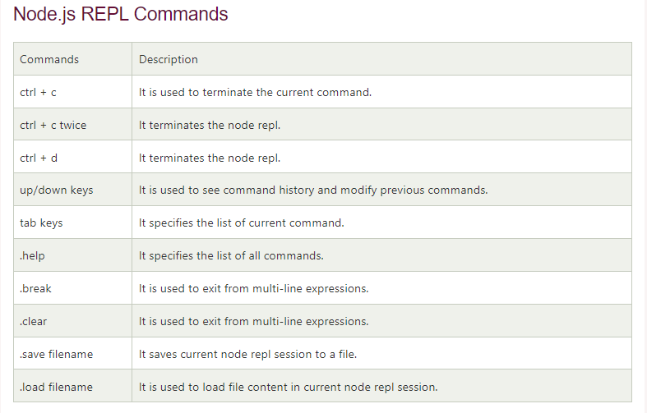
REPL

Slide 13
Asynchronous,Synchronous,Callbacks
Callback is an asynchronous equivalent for a function. A callback function is called at the completion of a given task. Node makes heavy use of callbacks. All the APIs of Node are written in such a way that they support callbacks.
For example, a function to read a file may start reading file and return the control to the execution environment immediately so that the next instruction can be executed. Once file I/O is complete, it will call the callback function while passing the callback function, the content of the file as a parameter. So there is no blocking or wait for File I/O. This makes Node.js highly scalable, as it can process a high number of requests without waiting for any function to return results.

Slide 14
Asynchronous,Synchronous,Callbacks
Blocking Code Example:
Create a text file named input.txt with the following content −
I will be printed first
Create a js file named main.js with the following code −
var fs = require("fs");
var data = fs.readFileSync('input.txt');
console.log(data.toString());
console.log("Program Ended");

Slide 15
Asynchronous,Synchronous,Callbacks
Now run the main.js to see the result −
$ node main.js
Verify the Output.
I will be printed first
Program Ended

Slide 16
Asynchronous,Synchronous,Callbacks
Non-Blocking Code Example
Create a text file named input.txt with the following content.
I will be printed last
Update main.js to have the following code −
var fs = require("fs");
fs.readFile('input.txt', function (err, data) {
if (err) return console.error(err);
console.log(data.toString());
});
console.log("Program Ended");

Slide 17
Asynchronous,Synchronous,Callbacks
Now run the main.js to see the result −
$ node main.js
Verify the Output.
Program Ended
I will be printed last

Slide 18
Asynchronous,Synchronous,Callbacks
These two examples explain the concept of blocking and non-blocking calls.
The first example shows that the program blocks until it reads the file and then only it proceeds to end the program.
The second example shows that the program does not wait for file reading and proceeds to print "Program Ended" and at the same time, the program without blocking continues reading the file.
Thus, a blocking program executes very much in sequence. From the programming point of view, it is easier to implement the logic but non-blocking programs do not execute in sequence. In case a program needs to use any data to be processed, it should be kept within the same block to make it sequential execution.

Slide 19
Streams
Streams are objects that let you read data from a source or write data to a destination in continuous fashion. In Node.js, there are four types of streams −
Readable − Stream which is used for read operation.
Writable − Stream which is used for write operation.
Duplex − Stream which can be used for both read and write operation.
Transform − A type of duplex stream where the output is computed based on input.

Slide 20
Streams
Each type of Stream throws several events at different instance of times. For example, some of the commonly used events are −
data − This event is fired when there is data is available to read.
end − This event is fired when there is no more data to read.
error − This event is fired when there is any error receiving or writing data.
finish − This event is fired when all the data has been flushed to underlying system.

Slide 21
Streams
Reading from a Stream
Create a text file named input.txt having the following content −
I am reading the file now!

Slide 22
Streams
Create a js file named main.js with the following code −
var fs = require("fs");
var data = '';
// Create a readable stream
var readerStream = fs.createReadStream('input.txt');
// Set the encoding to be utf8.
readerStream.setEncoding('UTF8');
// Handle stream events --> data, end, and error
readerStream.on('data', function(chunk) {
data += chunk;
});
readerStream.on('end',function() {
console.log(data);
});
readerStream.on('error', function(err) {
console.log(err.stack);
});

Slide 23
Streams
Writing to a Stream
var fs = require("fs");
var data = ‘ ';
// Create a writable stream
var writerStream = fs.createWriteStream('output.txt');
// Write the data to stream with encoding to be utf8
writerStream.write(data,'UTF8');
// Mark the end of file
writerStream.end();
// Handle stream events --> finish, and error
writerStream.on('finish', function() {
console.log("Write completed.");
});
writerStream.on('error', function(err) {
console.log(err.stack);
});

Slide 24
Streams
Piping the Streams
Piping is a mechanism where we provide the output of one stream as the input to another stream. It is normally used to get data from one stream and to pass the output of that stream to another stream. There is no limit on piping operations. a piping example for reading from one file and writing it to another file.

Slide 25
Streams
var fs = require("fs");
// Create a readable stream
var readerStream = fs.createReadStream('input.txt');
// Create a writable stream
var writerStream = fs.createWriteStream('output.txt');
// Pipe the read and write operations
// read input.txt and write data to output.txt
readerStream.pipe(writerStream);

Slide 26
File System
The Node File System (fs) module can be imported using the following syntax −
var fs = require("fs")
Synchronous vs Asynchronous
Every method in the fs module has synchronous as well as asynchronous forms. Asynchronous methods take the last parameter as the completion function callback and the first parameter of the callback function as error. It is better to use an asynchronous method instead of a synchronous method, as the former never blocks a program during its execution, whereas the second one does.

Slide 27
File System
Example
Create a text file named input.txt with the following content −
I am printed
Let us create a js file named main.js with the following code −
var fs = require("fs");
// Asynchronous read
fs.readFile('input.txt', function (err, data) {
if (err) {
return console.error(err);
}
console.log("Asynchronous read: " + data.toString());
});
// Synchronous read
var data = fs.readFileSync('input.txt');
console.log("Synchronous read: " + data.toString());
console.log("Program Ended");

Slide 28
File System
Open a File
Syntax
Following is the syntax of the method to open a file in asynchronous mode −
fs.open(path, flags[, mode], callback)
Parameters
Here is the description of the parameters used −
path − This is the string having file name including path.
flags − Flags indicate the behavior of the file to be opened. All possible values have been mentioned below.
mode − It sets the file mode (permission and sticky bits), but only if the file was created. It defaults to 0666, readable and writeable.
callback − This is the callback function which gets two arguments (err, fd).

Slide 29
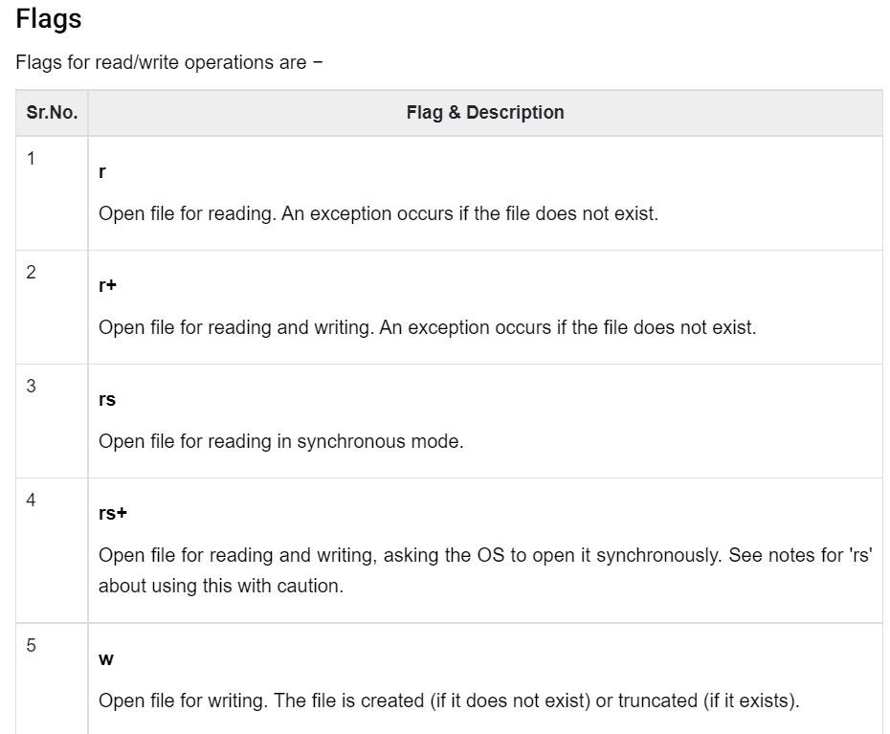
File System

Slide 30
File System
Let us create a js file named main.js having the following code to open a file input.txt for reading and writing.
var fs = require("fs");
// Asynchronous - Opening File
console.log("Going to open file!");
fs.open('input.txt', 'r+', function(err, fd) {
if (err) {
return console.error(err);
}
console.log("File opened successfully!");
});

Slide 31
File System
Get File Information
Syntax
Following is the syntax of the method to get the information about a file −
fs.stat(path, callback)
Parameters
Here is the description of the parameters used −
path − This is the string having file name including path.
callback − This is the callback function which gets two arguments (err, stats) where stats is an object of fs.Stats type which is printed below in the example.

Slide 32
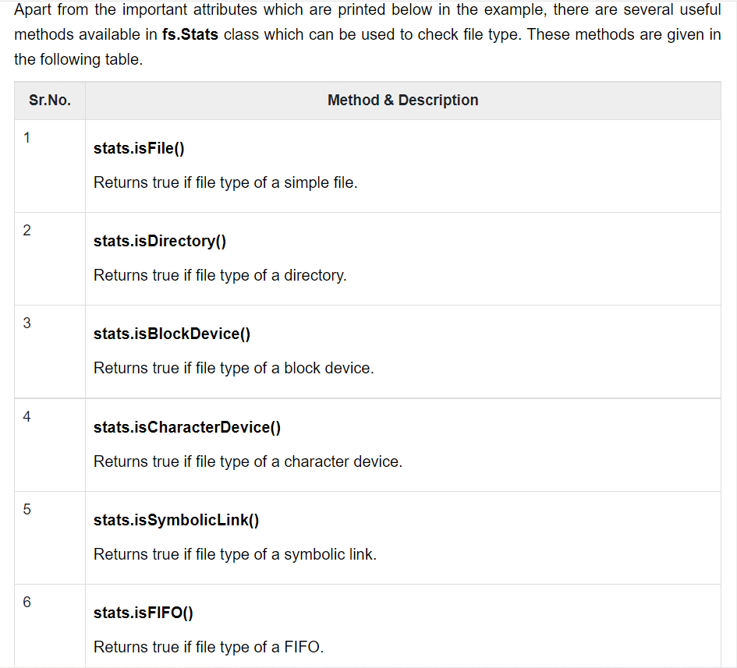

Slide 33
File System
var fs = require("fs");
console.log("Going to get file info!");
fs.stat('input.txt', function (err, stats) {
if (err) {
return console.error(err);
}
console.log(stats);
console.log("Got file info successfully!");
// Check file type
console.log("isFile ? " + stats.isFile());
console.log("isDirectory ? " + stats.isDirectory());
});

Slide 34
File System
Writing a File
Following is the syntax of one of the methods to write into a file −
fs.writeFile(filename, data[, options], callback)
This method will over-write the file if the file already exists.
Parameters
Here is the description of the parameters used −
path − This is the string having the file name including path.
data − This is the String or Buffer to be written into the file.
options − The third parameter is an object which will hold {encoding, mode, flag}. By default. encoding is utf8, mode is octal value 0666. and flag is 'w'
callback − This is the callback function which gets a single parameter err that returns an error in case of any writing error.

Slide 35
File System
var fs = require("fs");
console.log("Going to write into existing file");
fs.writeFile('input.txt', 'Simply Easy Learning!', function(err) {
if (err) {
return console.error(err);
}
console.log("Data written successfully!");
console.log("Let's read newly written data");
fs.readFile('input.txt', function (err, data) {
if (err) {
return console.error(err);
}
console.log("Asynchronous read: " + data.toString());
});
});

Slide 36
Using Buffers in Node.js
Pure JavaScript does not handle straight binary data very well, though JavaScript is Unicode friendly. When dealing with TCP streams and reading and writing to the filesystem, it is necessary to deal with purely binary streams of data.
Node has several strategies for manipulating, creating, and consuming octet ( One octet can be used to represent decimal values ranging from 0 to 255.) streams. Raw data is stored in instances of the Buffer class ( which is designed to handle raw binary data) in the node.
Note : An octet is a unit of digital information in computing and telecommunications that consist of eight bits. The term is often used when the term byte might be ambiguous, as historically there was no standard definition for the size of the byte.

Slide 37
Using Buffers in Node.js
A buffer is a region of a physical memory storage used to temporarily store data while it is being moved from one place to another. In node, each buffer corresponds to some raw memory allocated outside V8. A buffer acts like an array of integers, but cannot be resized. The Buffer class is global. It deals with binary data directly and can be constructed in a variety of ways.

Slide 38
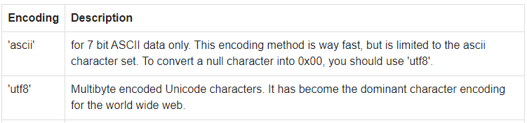
Using Buffers in Node.js
Encoding list, used with node
Converting between Buffers and JavaScript string objects requires an explicit encoding method. The following table shows the different string encodings.

Slide 39

Using Buffers in Node.js
Creating Buffers in Node
There are several ways to create new buffers.
new Buffer(n)
new Buffer(n) is used to create a new buffer of 'n' octets, where 'n' is a number
In the following example 'buffer' contains 10 octets.

Slide 40

Using Buffers in Node.js
new Buffer(arr):
new Buffer(arr) is used to create a new buffer, using an array of octets.

Slide 41
Using Buffers in Node.js
new Buffer(str, [encoding]):
new Buffer(str, [encoding]) is used to create a new buffer, contains a given string.

Slide 42
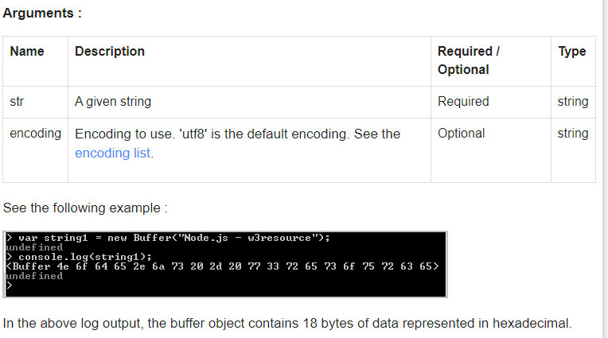
Using Buffers in Node.js

Slide 43
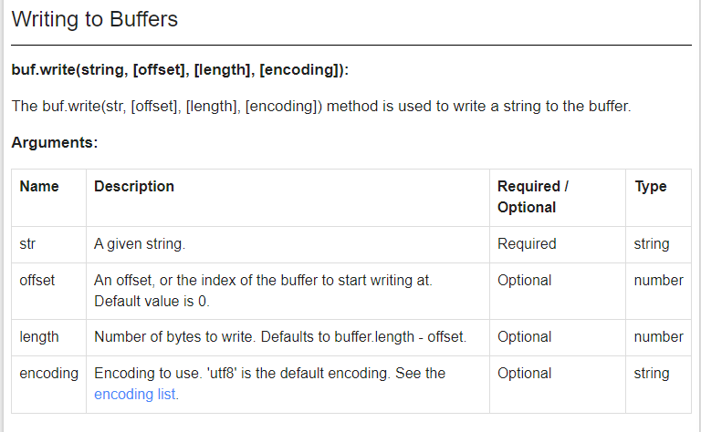
Using Buffers in Node.js

Slide 44
Using Buffers in Node.js

Slide 45
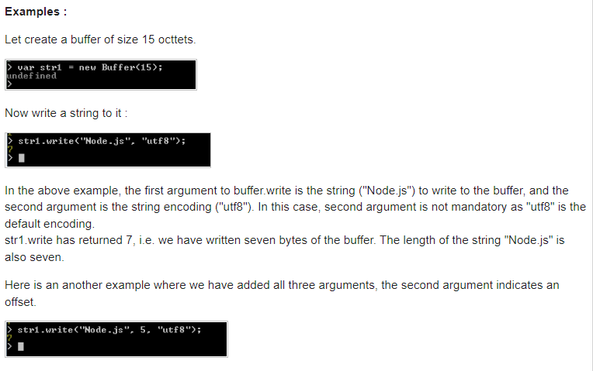
Using Buffers in Node.js

Slide 46
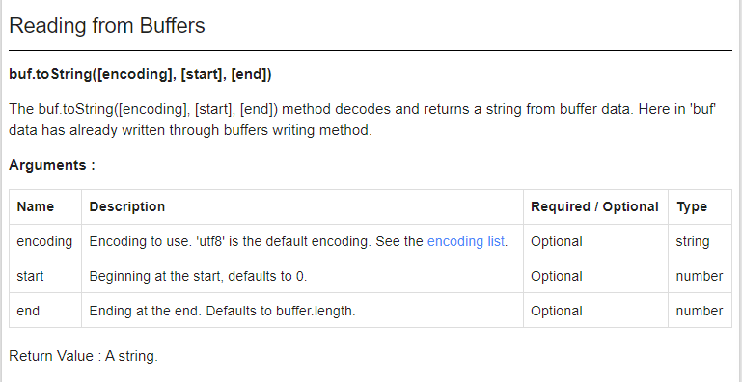
Using Buffers in Node.js

Slide 47
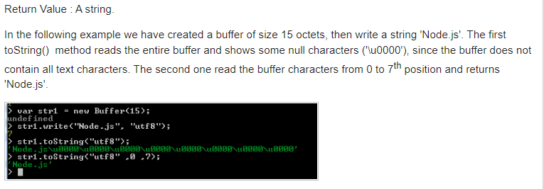
Using Buffers in Node.js

Slide 48
Node.js Event Loop
Node.js is a single-threaded event-driven platform that is capable of running non-blocking, asynchronously programming. These functionalities of Node.js make it memory efficient. The event loop allows Node.js to perform non-blocking I/O operations despite the fact that JavaScript is single-threaded. It is done by assigning operations to the operating system whenever and wherever possible.
Most operating systems are multi-threaded and hence can handle multiple operations executing in the background. When one of these operations is completed, the kernel tells Node.js and the respective callback assigned to that operation is added to the event queue which will eventually be executed.

Slide 49
Node.js Event Loop
Features of Event Loop:
Event loop is an endless loop, which waits for tasks, executes them and then sleeps until it receives more tasks.
The event loop executes tasks from the event queue only when the call stack is empty i.e. there is no ongoing task.
The event loop allows us to use callbacks and promises.
The event loop executes the tasks starting from the oldest first.

Slide 50
Node.js Event Loop
Example:
console.log("This is the first statement");
setTimeout(function(){
console.log("This is the second statement");
}, 1000);
console.log("This is the third statement");
Output:
This is the first statement
This is the third statement
This is the second statement

Slide 51
Node.js Event Loop
In the above example, the first console log statement is pushed to the call stack and “This is the first statement” is logged on the console and the task is popped from the stack. Next, the setTimeout is pushed to the queue and the task is sent to the Operating system and the timer is set for the task. This task is then popped from the stack. Next, the third console log statement is pushed to the call stack and “This is the third statement” is logged on the console and the task is popped from the stack.
When the timer set by setTimeout function (in this case 1000 ms) runs out, the callback is sent to the event queue. The event loop on finding the call stack empty takes the task at the top of the event queue and sends it to the call stack. The callback function for setTimeout function runs the instruction and “This is the second statement” is logged on the console and the task is popped from the stack.

Slide 52
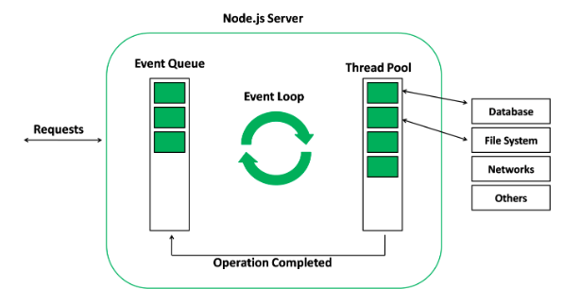
Node.js Event Loop
When the thread pool completes a task, a callback function is called which handles the error(if any) or does some other operation. This callback function is sent to the event queue. When the call stack is empty, the event goes through the event queue and sends the callback to the call stack.
The following diagram is a proper representation of the event loop in a Node.js server:

Slide 53
Net Module
Node.js net module is used to create both servers and clients. This module provides an asynchronous network wrapper and it can be imported using the following syntax.
var net = require("net")

Slide 54
Net Module
Create a js file named server.js with the following code −File: server.js
var net = require('net');
var server = net.createServer(function(connection) {
console.log('client connected');
connection.on('end', function() {
console.log('client disconnected');
});
connection.write('Hello World!\r\n');
connection.pipe(connection);
});
server.listen(8080, function() {
console.log('server is listening');
});

Slide 55
Net Module
Create a js file named client.js with the following code −
File: client.js
var net = require('net');
var client = net.connect({port: 8080}, function() {
console.log('connected to server!');
});
client.on('data', function(data) {
console.log(data.toString());
client.end();
});
client.on('end', function() {
console.log('disconnected from server');
});

Slide 56
Web Module
What is a Web Server?
A Web Server is a software application which handles HTTP requests sent by the HTTP client, like web browsers, and returns web pages in response to the clients. Web servers usually deliver html documents along with images, style sheets, and scripts.
Most of the web servers support server-side scripts, using scripting languages or redirecting the task to an application server which retrieves data from a database and performs complex logic and then sends a result to the HTTP client through the Web server.
Apache web server is one of the most commonly used web servers. It is an open source project.

Slide 57
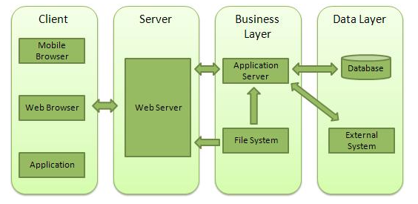
Web Module
Web Application Architecture
A Web application is usually divided into four layers −

Slide 58
Web Module
Client − This layer consists of web browsers, mobile browsers or applications which can make HTTP requests to the web server.
Server − This layer has the Web server which can intercept the requests made by the clients and pass them the response.
Business − This layer contains the application server which is utilized by the web server to do the required processing. This layer interacts with the data layer via the database or some external programs.
Data − This layer contains the databases or any other source of data

Slide 59
Web Module
Creating a Web Server using Node
Node.js provides an http module which can be used to create an HTTP client of a server. Following is the bare minimum structure of the HTTP server which listens at 8081 port.
Create a js file named server.js −
File: server.js

Slide 60
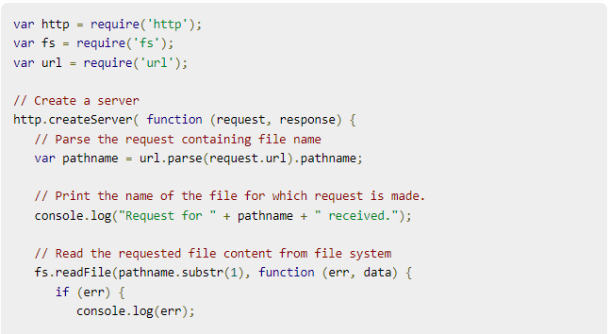
Web Module

Slide 61
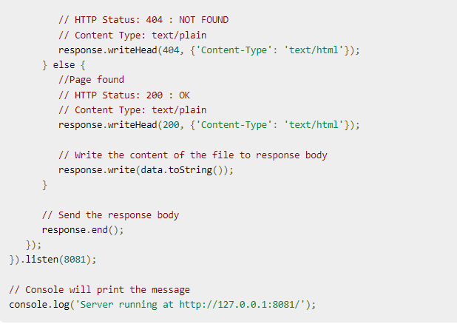
Web Module

Slide 62
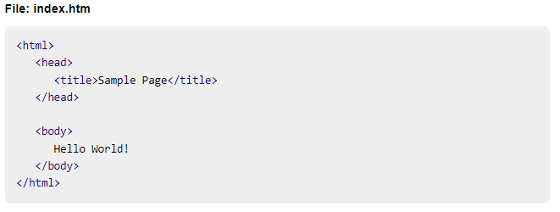
Web Module
run the server.js to see the result −
$ node server.js

Slide 63
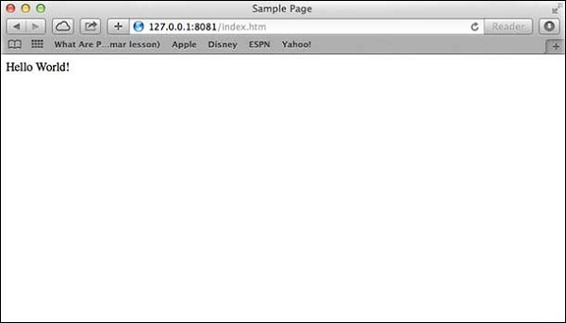
Web Module
Verify the Output.
Server running at http://127.0.0.1:8081/
Make a request to Node.js server
Open http://127.0.0.1:8081/index.htm in any browser to see the following result.

Slide 64
Web Module
Verify the Output at server end.
Server running at http://127.0.0.1:8081/
Request for /index.htm received.
Creating Web client using Node
A web client can be created using http module.
Now run the client.js from a different command terminal other than server.js to see the result

Slide 65
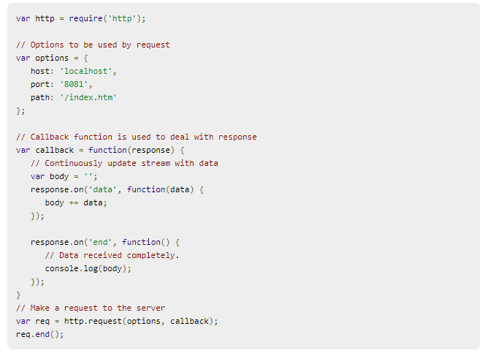
Web Module

